Slide 1

COLLEGE PLACEMENT ANALYSIS

Slide 2
CONTENTS
Abstract
Project overview
Introduction
Dataset Details
Data Cleaning
Dataset Description
Salary distribution analysis
Gender wise distrivution
Exploratory data analysis
System Requirements
Features importance and results
Architecture
Uses of data analysis library
Objectives
Advantages
Conclusion

Slide 3
ABSTRACT
Analysed student placement data of 100 students.
Used CGPA, Branch, and Internship details to study placement trends.
Applied a Random Forest model to predict student placements.
Created charts and graphs to visualize placement insights.
Helps students and colleges improve placement opportunities.

Slide 4
PROJECT OVERVIEW
This project analyzes student placement data and identifies factors affecting Placements such as:
CGPA
Branch
Internships
Gender
Salary package
Purpose: Understand placement trends and predict placement chances.

Slide 5
INTRODUCTION
College placements are an important part of a student's academic and professional journey. This project analyses student placement data using Python and data analysis techniques to identify factors that influence placement success.
It also uses machine learning to predict placement opportunities and provides valuable insights to help colleges and students improve placement outcomes.

Slide 6
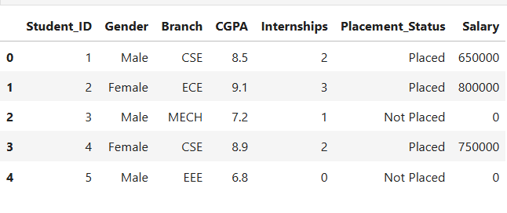
DATASET DETAILS

Slide 7
DATA CLEANING
Checked Missing Values
Identified missing or null values in the dataset and handled them appropriately to ensure data accuracy and consistency.
Removed Duplicates
Detected and removed duplicate records to avoid redundancy and improve the reliability of the analysis.
Verified Data Types
Checked whether each column had the correct data type (integer, float, string, etc.) for proper processing and calculations.
Prepared Data for Analysis
Organized and formatted the cleaned dataset, making it ready for visualization, statistical analysis, and machine learning tasks.

Slide 8
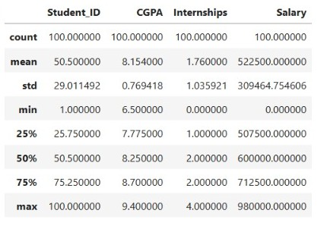
DATASET DESCRIPTION
Dataset contains information about students including:

Slide 9
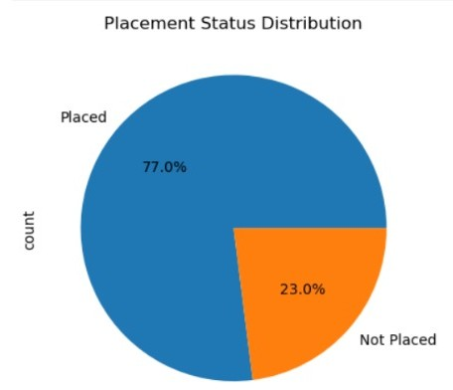
SALARY DISTRIBUTION ANALYSIS
Salary distribution shows package variations among placed students.
Observation:Students with higher CGPA and internships generally receive better salary packages.

Slide 10
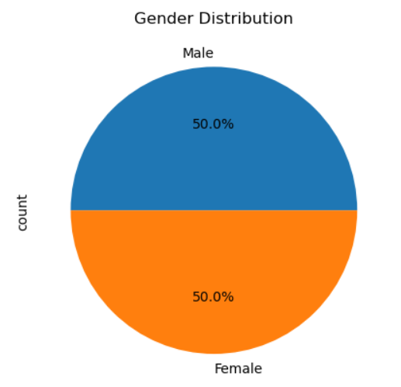
GENDER-WISE DISTRIBUTION
This analysis compares placement rates among male and female students.
Observation:Placement opportunities are based mainly on skills and academic performance.

Slide 11
EXPLORATORY DATA ANALYSIS
Exploratory Data Analysis (EDA) is used to understand the dataset by applying statistical techniques and visualizations. It helps identify patterns, trends, and relationships between different variables before building machine learning models.
Placement Count Analysis: Analyzes the number of students who are placed and not placed. Helps understand the overall placement rate of the college.
Branch Analysis: Examines placement performance across different branches such as CSE, ECE, EEE, Mechanical, and Civil. Identifies which branch has the highest placement percentage. Useful for comparing placement opportunities among departments.
Gender Analysis: Studies placement distribution based on gender. Compares placement rates of male and female students. Helps determine whether gender has any impact on placement outcomes.
Salary Analysis: Analyzes salary packages offered to placestudents.Calculates minimum, maximum, and average salary. Visualizes salary distribution using histograms and box plots. Helps understand salary trends and package variations among students.

Slide 12
SYSTEM REQUIREMENTS
HARDWARE REQUIREMENTS
• Processor: Intel Core i3 or above
• RAM: 4 GB or above
• Hard Disk: 20 GB Free Space 1
• System Type: 64-bit Operating System

Slide 13
Software Requirements
Operating System: Windows 10/11
Python 3.x
Jupyter notebook
Pandas Library
NumPy Library
Matplotlib Library
Scikit-Learn Library
Anaconda Distribution

Slide 14
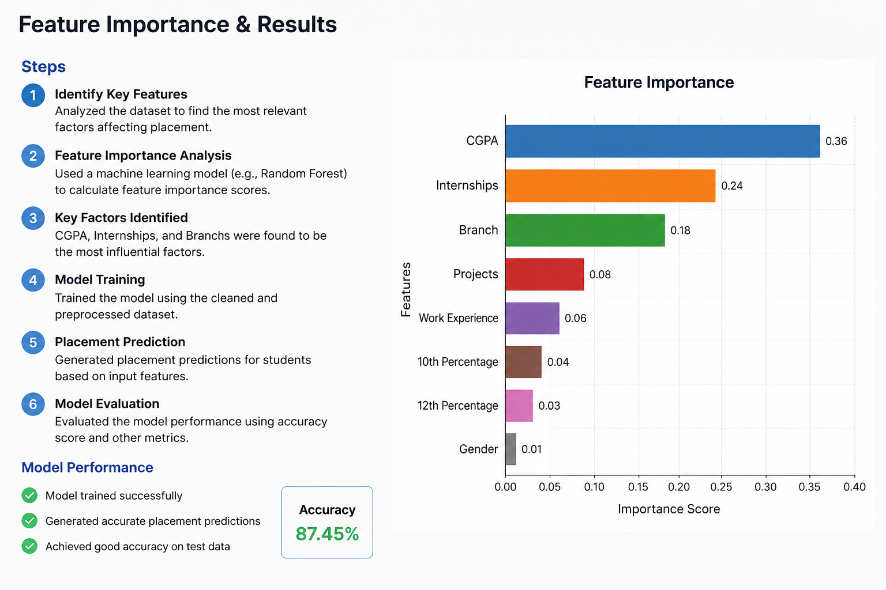
FEATURE IMPORTENCE AND RESULTS

Slide 15
ARCHITECTURE
The architecture of the College Placement Analysis project consists of multiple stages
Data Collection
Placement dataset containing student information is collected
Data Loading
The dataset is loaded using Pandas.
Data Preprocessing
Data is checked for missing values and prepared for analysis.
Exploratory Data Analysis
Statistical analysis and visualization are performed
Data Visualization
Charts and graphs are generated using Matplotlib
Machine Learning Model
Random Forest Classifier is trained using select features.
Prediction
The trained model predicts placement chances.
Results and Conclusion
Insights and prediction results are analysed and documented

Slide 16
USES OF DATA ANALYSIS LIBRARY
Pandas: Used to load, organize, and analyse the dataset.
NumPy: Used for mathematical calculations and numerical operations.
Matplotlib: Used to create charts and graphs for data visualization.
Scikit-Learn: Used to build the Random Forest model for placement prediction.
Jupyter Notebook: Used to write, run, and document Python code interactively.

Slide 17
OBJECTIVES
✔️ Analyze student placement trends
✔️ Perform data visualization
✔️ Identify placement patterns
✔️ Build a Machine Learning model
✔️ Evaluate model performance
✔️ Study branch-wise placements
✔️ Study gender-wise placements
✔️ Build prediction model
✔️ Analyze salary distribution

Slide 18
ADVANTAGES
• Provides graphical visualization of placement trends.
• Improves understanding of salary distribution patterns.
• Predicts placement chances using Machine Learning.
• Easy to implement and maintain.
• Reduces manual analysis effort.
• Useful for educational institutions and placement cells

Slide 19
CONCLUSION
The College Placement Analysis project helps understand student placement trends using data analysis and machine learning. It analyses factors such as CGPA, Branch, and Internships that affect placement opportunities. Charts and graphs are used to visualize placement and salary trends clearly. The Random Forest model predicts the chances of student placement effectively. This project helps colleges and students make better decisions to improve placement outcomes.

Slide 20


